Slide 1

NORRISTOWN MUNICIPAL AUTHORITY
IMPROVING THE SEWERS
IN NORRISTOWN IS NOT
A PIPE DREAM
Authority Meeting — May 20th
Notes:
THIS PRESENTATION IS TO GIVE SOME INSIGHT AS TO HOW WE VIEW, PLAN, IMPROVE, AND MAINTAIN

Slide 2


AREAS OF FOCUS
Supporting
Development
Reducing
Inflow/Infiltration
Maintaining
the Sewers
Kennedy Kenrick, State Hospital & small developments
7-year cycle: metering, televising & targeted correction
Weekly cleaning, PA 1 Call marking & blockage response

Slide 3
SUPPORTING DEVELOPMENT
Kennedy Kenrick Site
State Hospital Site
Small Developments
Major redevelopment project in Norristown
Sewer capacity analysis and infrastructure upgrades completed (2023)
New connections designed to support planned residential/commercial use
Historic campus redevelopment requiring new sewer planning
Authority coordinated capacity and routing assessments
Infrastructure readied to serve future mixed-use development (Washington St. Interceptor)
WN Township Forensic Hospital: 125,000 gpd max. Estimated completion 2033 (sewer planning module- signoff)
Norristown Site development: TBD
Routine permit reviews for residential infill and commercial projects
Ensures all new connections meet Authority standards
Ongoing collaboration with municipal planning department
Fix any sewers that need repair
Chapter 94: 5-year projected flow increase 150,000gpd + 125,000gpd (WN Forensic Hospital) = 275,000gpd

Slide 4
WHAT IS INFLOW / INFILTRATION?
INFLOW
INFILTRATION
Stormwater that enters the sanitary sewer directly through improper connections — such as roof drains, sump pumps, or cross-connected storm drains — typically during and after rain events.
Groundwater that seeps into the sewer system through cracks, faulty pipe joints, or deteriorated manholes. Occurs year-round but peaks during wet seasons when the water table is high.
WHY IT MATTERS
Excess I/I increases treatment costs, can cause sanitary sewer overflows (SSOs), and reduces available system capacity for new development.
Notes:
All of our Priority based projects over the next 2-3 years are based specifically on eliminating/minimizing this problem
Inflow = our maintenance, we are constantly looking for cracked or broken manhole covers and ( we have inflow rain guards installed on more than 50% of our manholes to reduce wet weather surges)

Slide 5

I/I REDUCTION — 7-YEAR CYCLE PROGRAM
1
2
3
4
Flow Metering
Identify High-Flow Areas
CCTV Televising
Correction Program
Temporary meters placed throughout the system to measure flows and identify sub-basins with high I/I.
Data analysis pinpoints the specific drainage areas contributing the most excess flow.
Pipe inspection cameras document the condition of sewers in high-flow zones, locating cracks and defects.
Engineers design targeted repairs: pipe replacement, cured-in-place pipe (CIPP) lining, and manhole rehabilitation.

Slide 6

CURRENT CORRECTION PROGRAM
Three active high-flow priority areas are currently under correction:
PRIORITY A
PRIORITY B
PRIORITY C
Highest Need
Moderate Need
Planned
Most severe I/I detected during metering
CCTV inspection complete
Design and construction underway
Grant funded @ $352,000
Scheduled completion - August
Elevated flows confirmed in this sub-basin
Defects documented via televising
Correction scheduled for fiscal year 2027
Priority B&C Grant Application submitted for $942,000
Measurable I/I identified
Further assessment in progress
Programmed for future construction phase
Grant dependent or revenue driven 2027 or 2027-2028

Slide 7
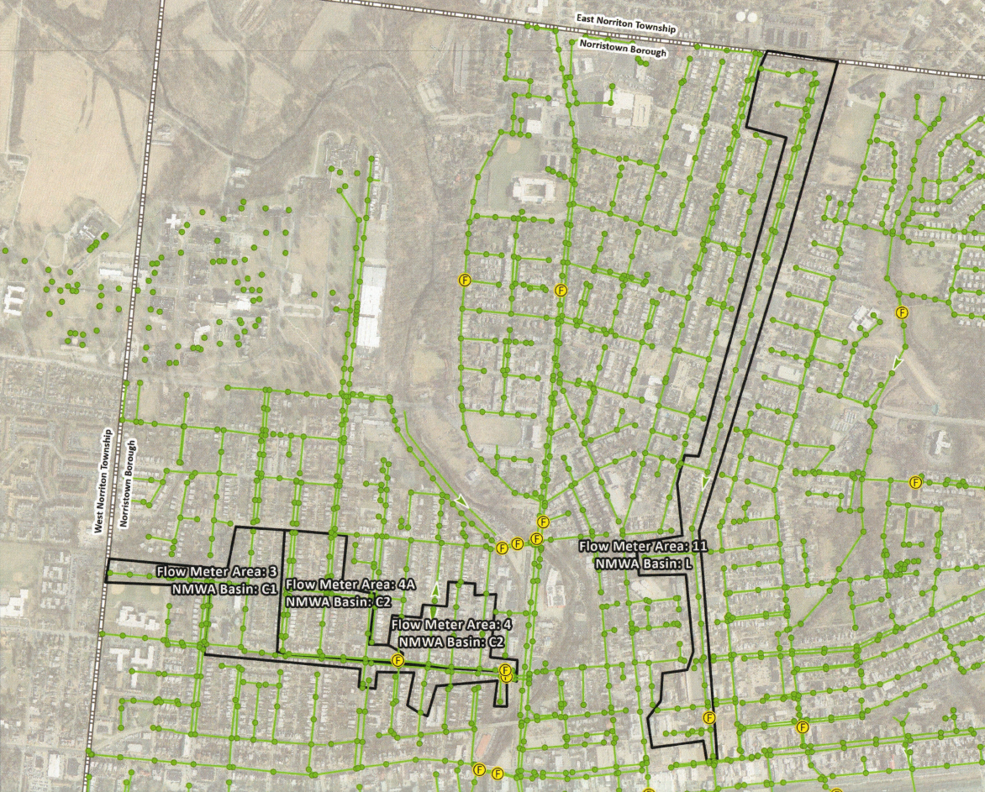
High Flow Priority Areas
Flow Meter Areas 3, 4/4A, and 11 — the three high-flow priority basins.
Notes:
Breakdown of A,B,C

Slide 8


MAINTAINING THE SEWERS
Weekly Cleaning
PA 1 Call (Utility Marking)
Blockage Response
High-velocity hydro-jetting of sewer mains on a rotating schedule
Keeps lines clear of debris, grease buildup, and root intrusion
Average footage cleaned per week: 5,000 – 10,000 LF per week
Keep in mind that we have 1 person dedicated to the collection system work. 30,000 LF per mo. to clean entire system yearly.
We also have a Root control program that averages 6,000 LF per year
1 mile = 5,280 LF
Required by law before any excavation in Pennsylvania
Color-coded markings identify the location of buried utilities
Authority completes an average of 120 - 300 marks per month (4-10 per day)
Colors: Blue = Water, Green = Sewer, Orange = Communications, Red = Electric, Yellow = Gas
Crew responds to reported blockages throughout the service area
Investigation determines whether blockage is on public main or private lateral
Number of blockages per year: 2025 there were 88 blockage calls and only 15 were ACTUAL blockages
Percentage that are Authority responsibility: 17% Keep in mind 10,000 EDU’s.
80% of our OT is collection system callouts with 90% of these callouts being PA One, not blockages
Notes:
Find math breakdown for what an operator costs and each callout costs
$110 + $85 = $185 per blockage (replacement costs=fuel, water, equipment+parts) working hours no blockage costs $8 how many rain guards are installed 90% of manholes? ($2,000+$20,000 -2 basement cleanouts) hiring additional person = $85,000

Slide 9
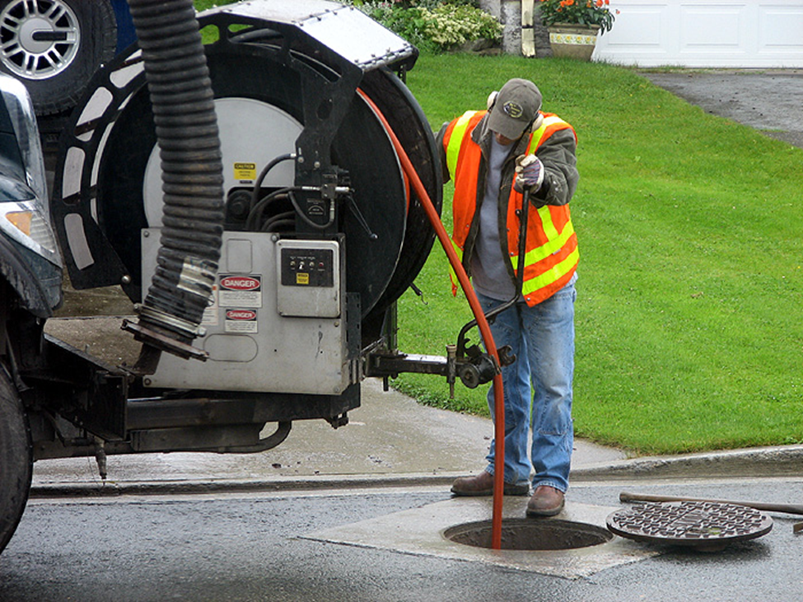
Weekly Cleaning
High-velocity hydro-jetting of sewer mains clears debris, grease, and root intrusion across the collection system.

Slide 10
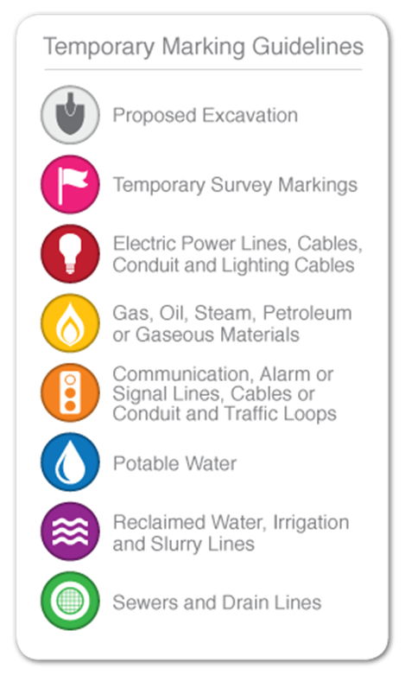
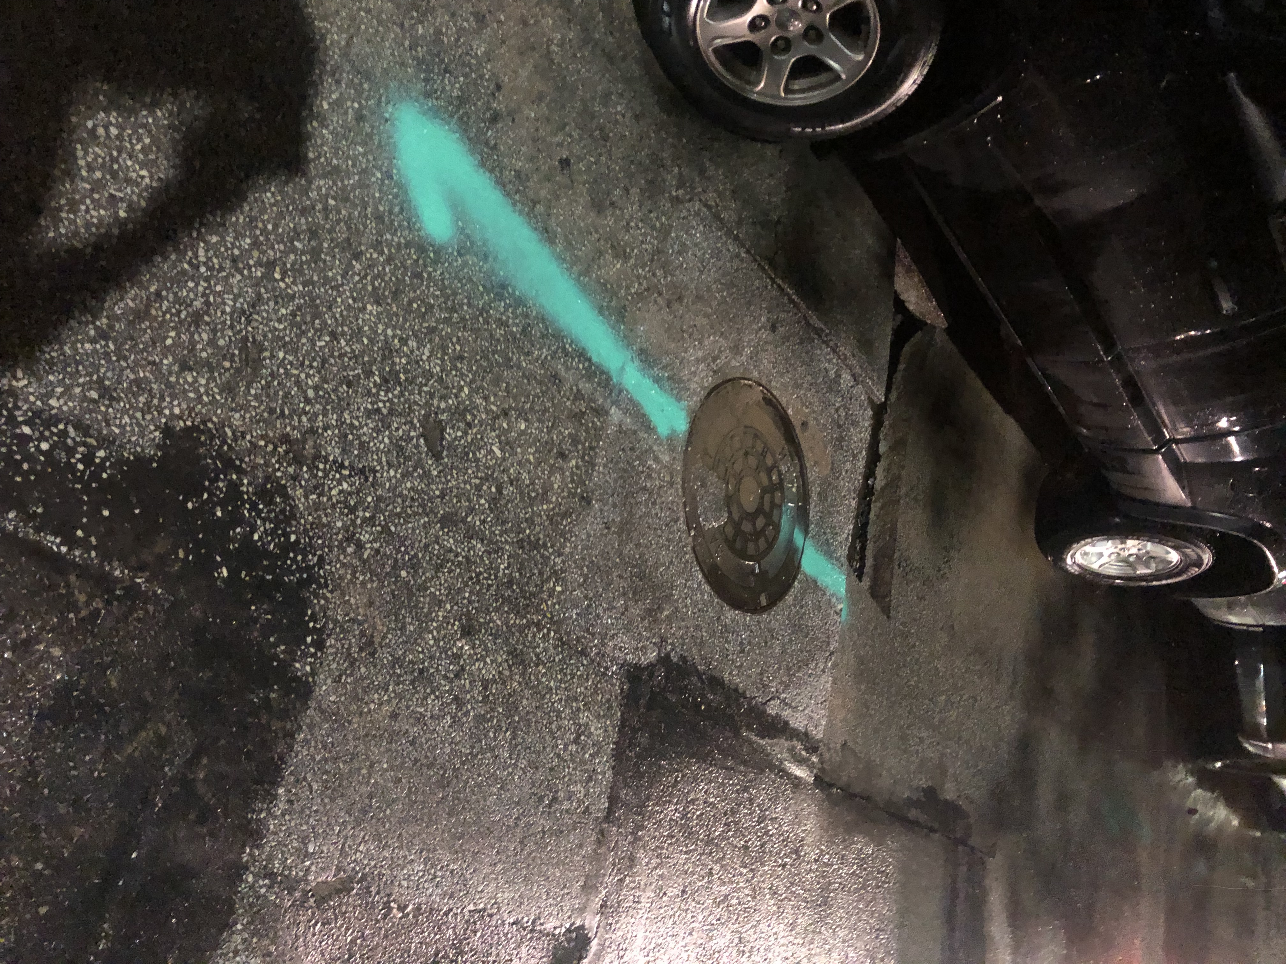
PA 1 Call Utility Marking
Standardized color codes (left) guide field crews when marking buried utilities. Green identifies sewer and drain lines (right) prior to any excavation work.

Slide 11
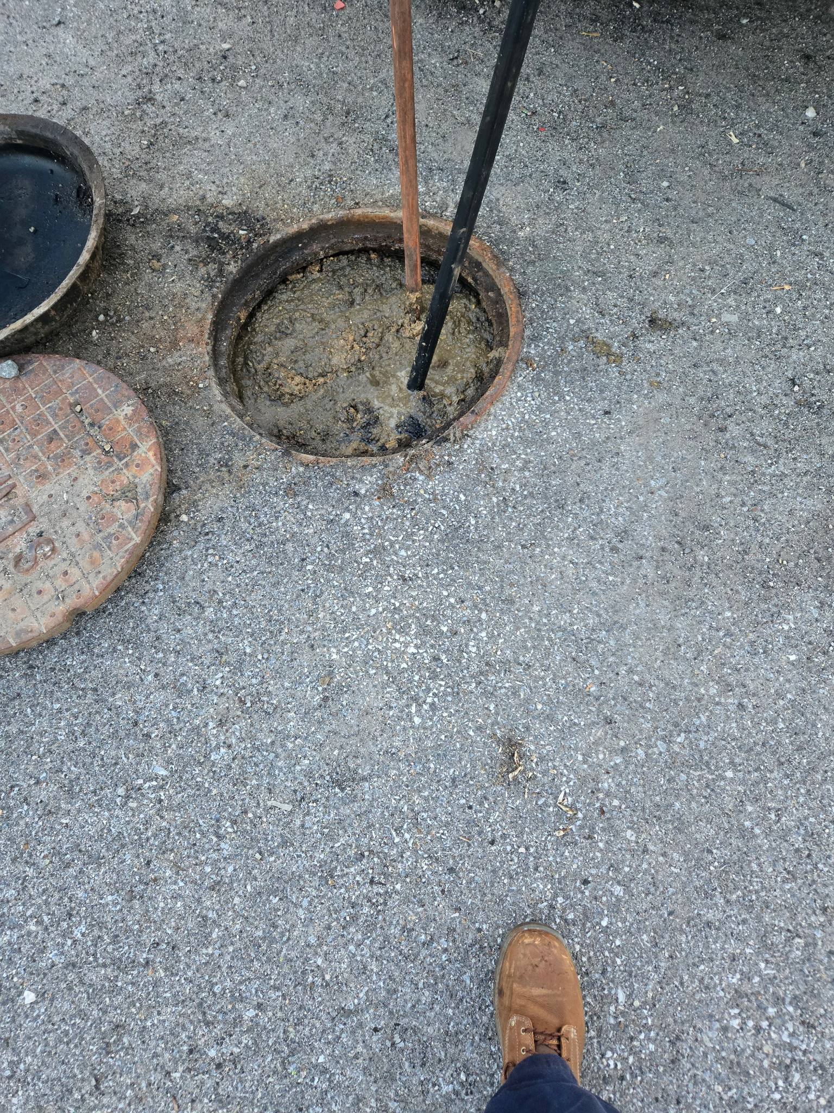
Blockage Response
Crews respond on-site to clear active blockages — manually breaking up grease, debris, and obstructions to restore flow.

Slide 12
IMPROVING THE SEWERS
IN NORRISTOWN IS NOT
A PIPE DREAM
Supporting Development • Reducing I/I • Maintaining the System
Questions & Discussion
Norristown Municipal Authority | May 20th Authority Meeting

