Slide 1

NORRISTOWN WASTEWATER
CAPITAL PROJECTS – 2026/2027
Project Overview
Electrical Service Relocation
Flood Resiliency Project
Priority A Sewer Repair
Plant Fence
Priority B & C

Slide 2
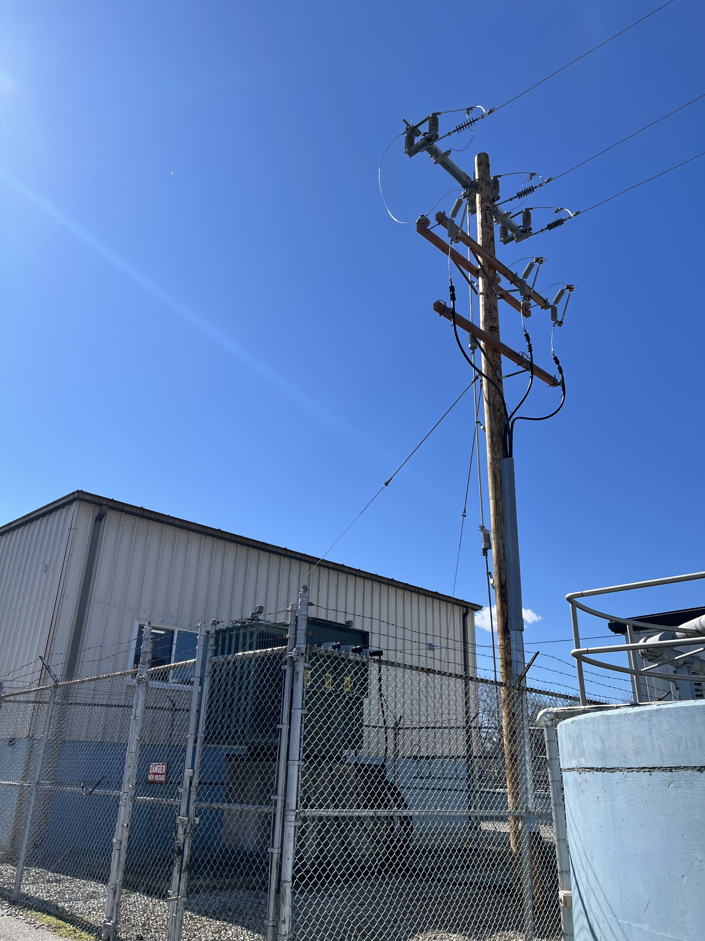
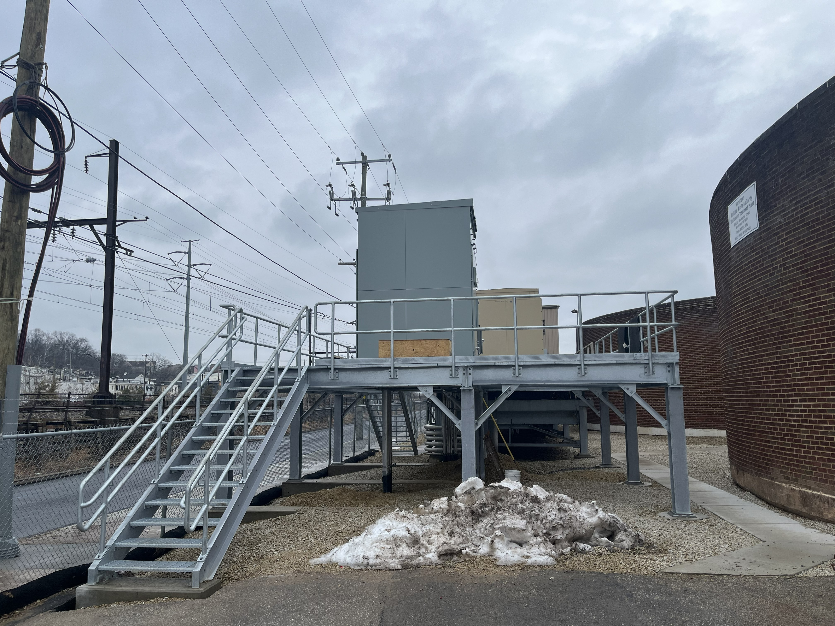
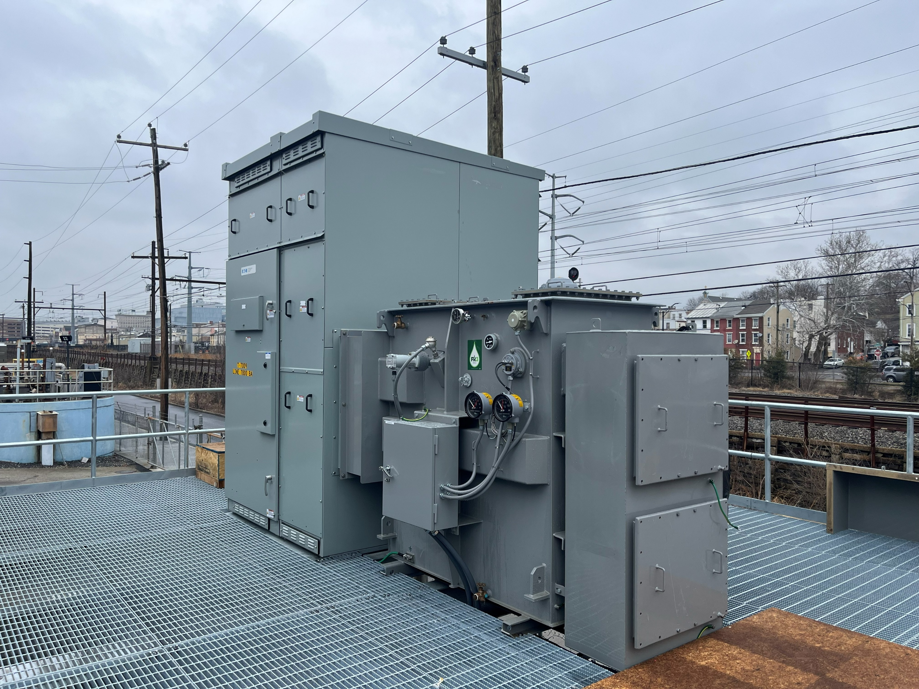
CAPITAL PROJECTS - 2026
Electrical Service Relocation
New Transformer & Switchgear
Elevated Platform
Completion May 2026

Slide 3
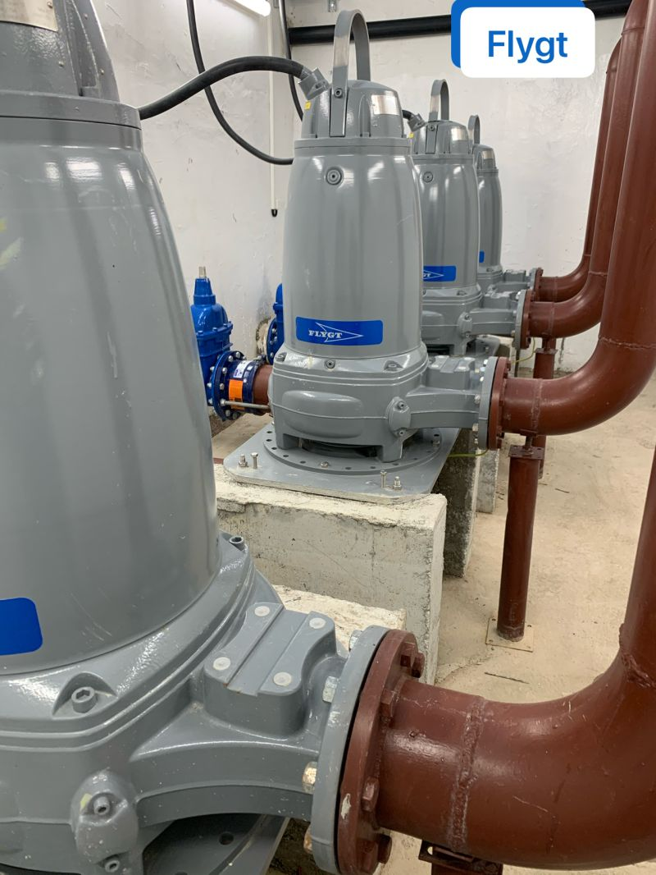
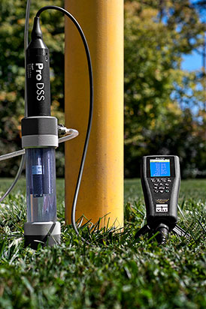
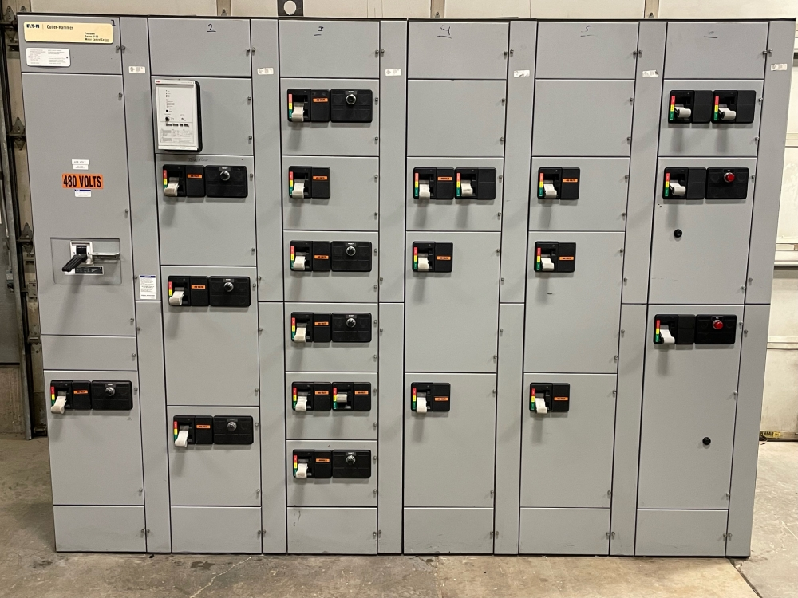
CAPITAL PROJECTS - 2026
Flood Resiliency
Grant Funded at $450,000
Submersible Pumps, Probes, Sensors and Controls
Completion – Fall 2026

Slide 4
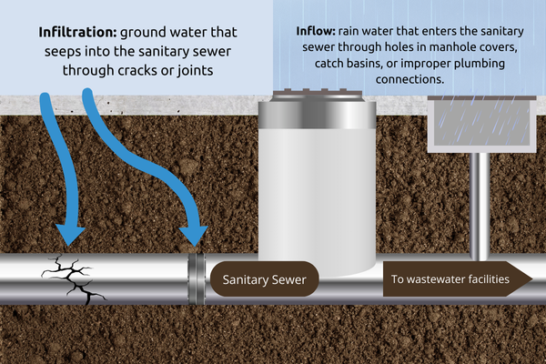
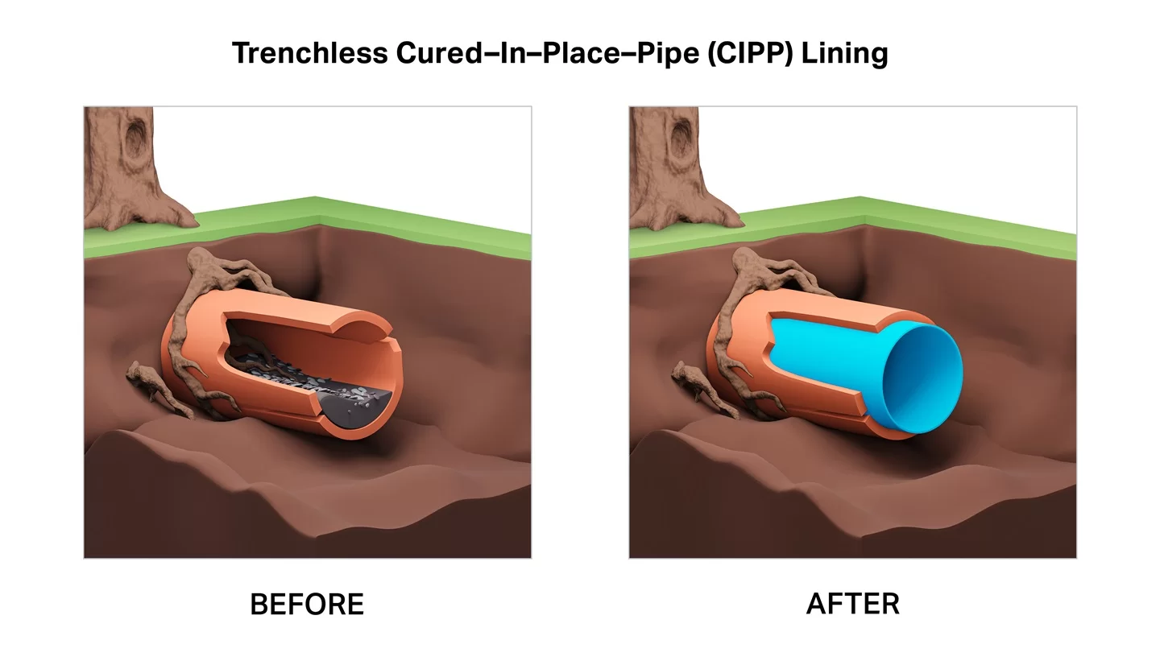
CAPITAL PROJECTS – 2026
Priority A Sewer Repairs
  Highest Priority I&I work
  LSA Grant Funded @100%
  Completion – Fall 2026

Slide 5
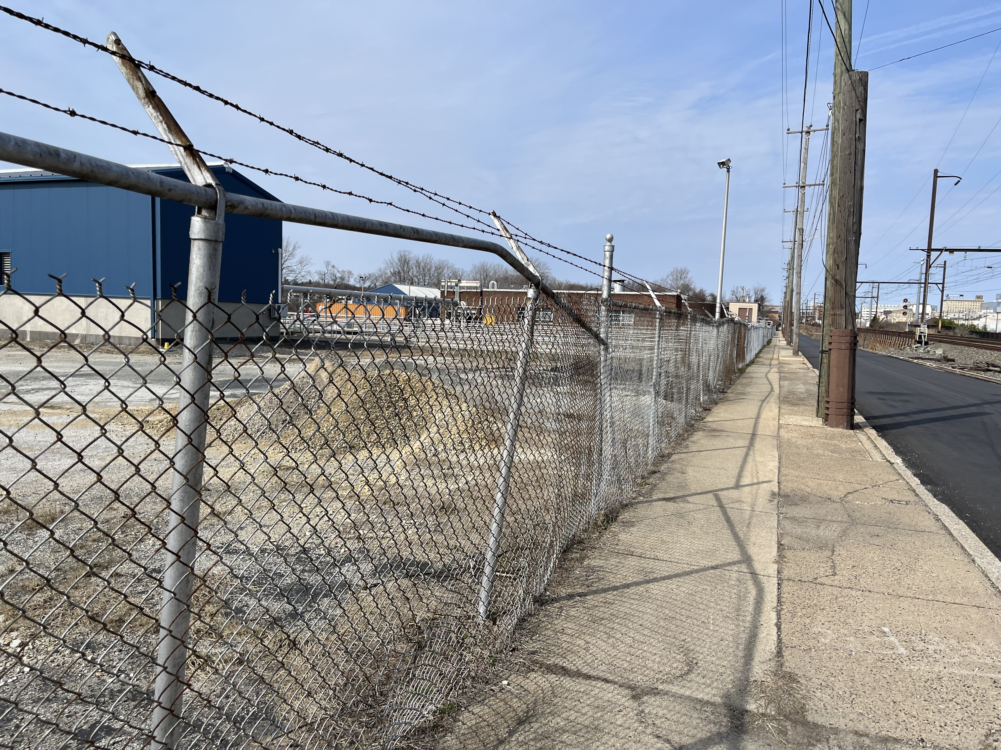
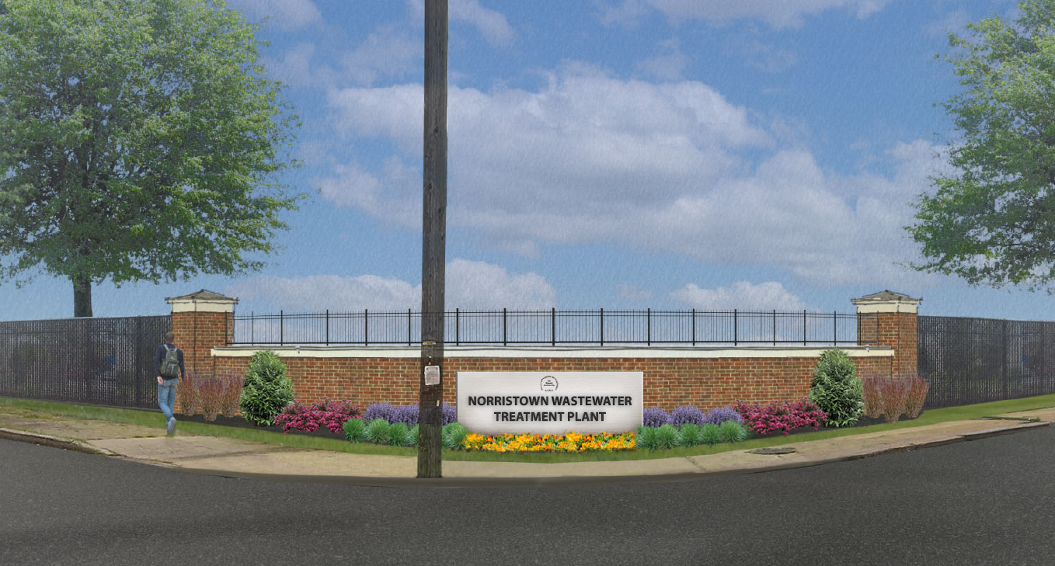
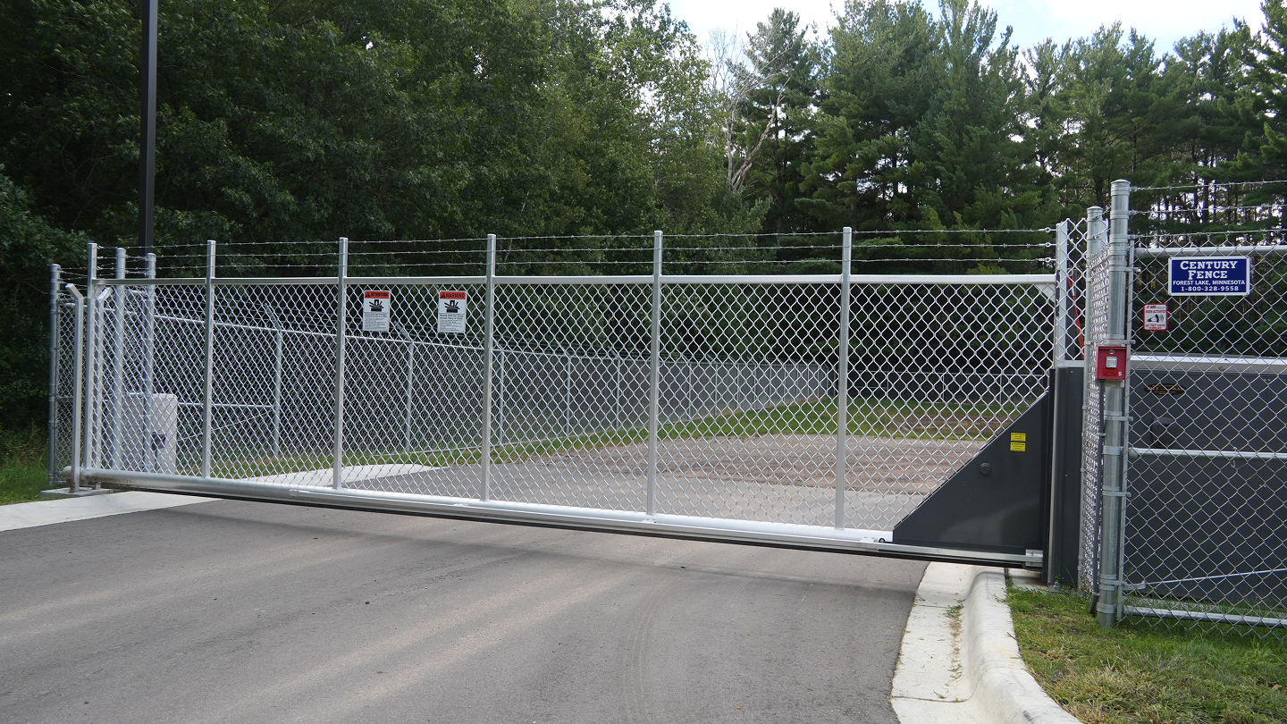
CAPITAL PROJECTS - 2027
WWTP Fence Replacement
Security & Aesthetics Upgrade
Gates and Signage
Completion – Late Spring/Early Summer 2027

Slide 6
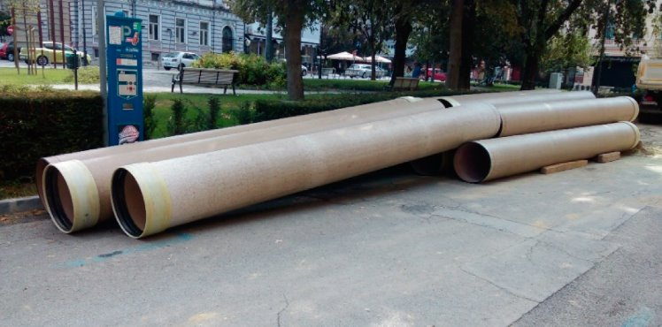
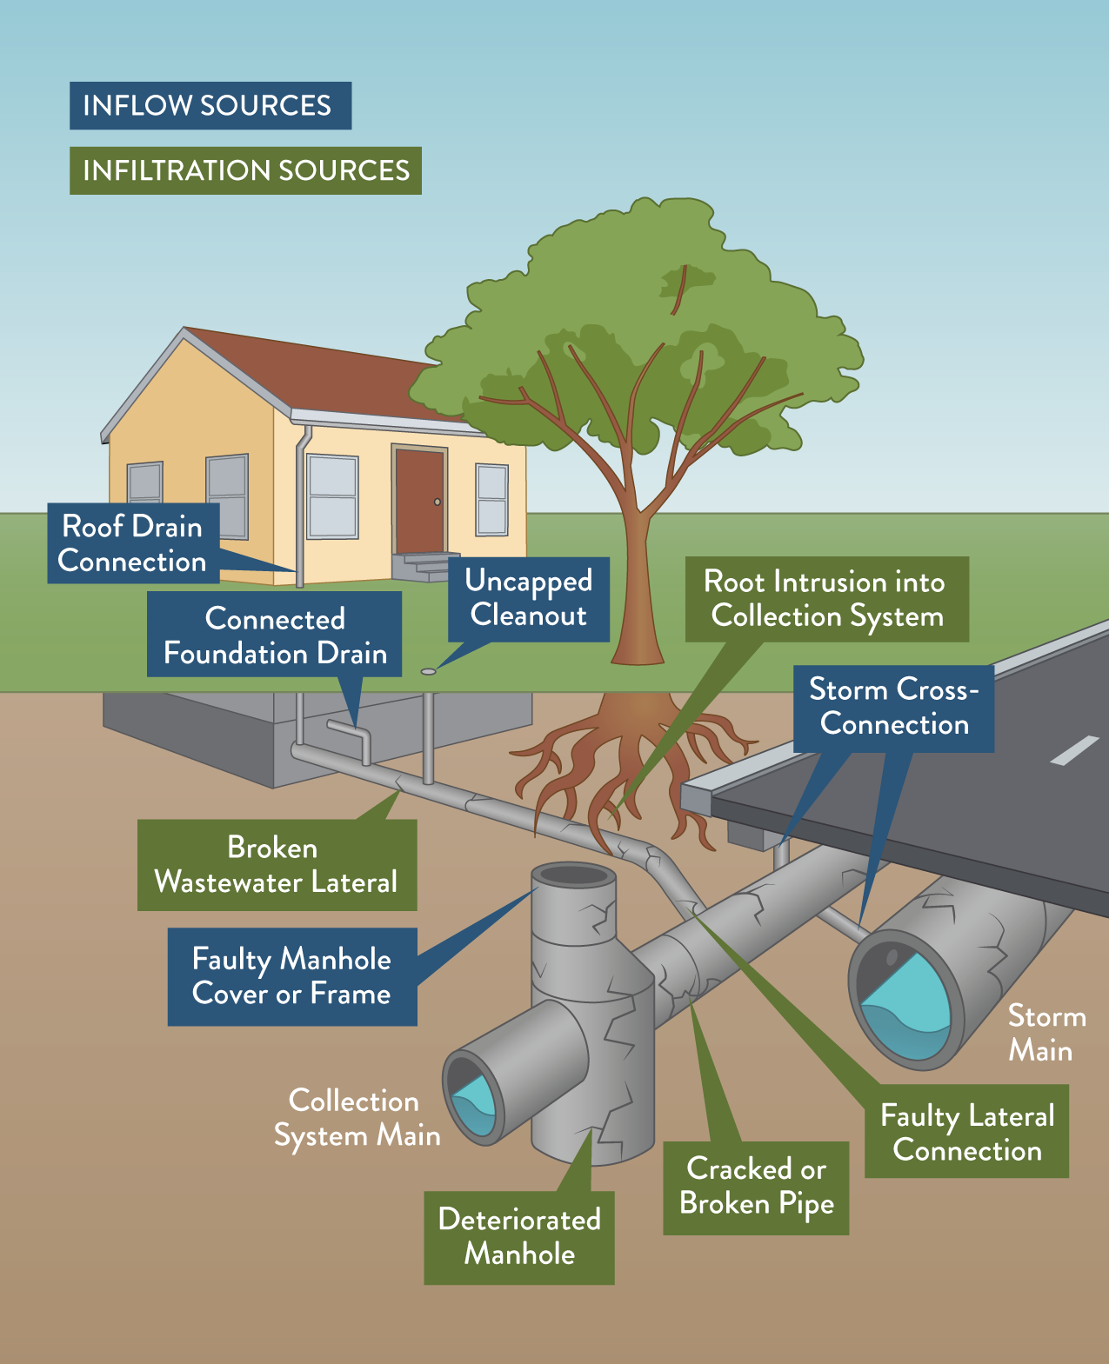
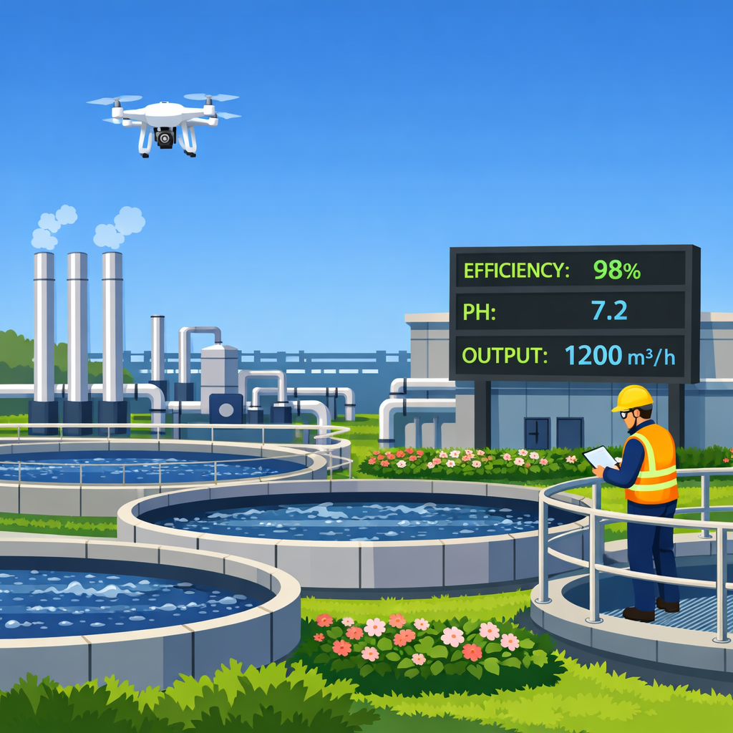
CAPITAL PROJECTS - 2027
Priority B & C - Collection System
Phase 2 of the collection system improvement plan
Project will be Grant funded or split into 2 phases – Pending
Completion TBD

Slide 7

NORRISTOWN WASTEWATER
CAPITAL PROJECTS – 2026/2027
Concluding Remarks
In summary
Progress Update - September
Closing statement and Questions....

